Slide 1

Data Engineering
Bonus Episode
OLAP Cubes: Resistance is Futile

Slide 2
Overview
What are OLAP Cubes?
OLAP Cube Operations
Rollup and Drill Down
Slice
Dice
Query Optimization
Delivery to Users
Oracle Example
FASP Demo / Usage
Questions?

Slide 3
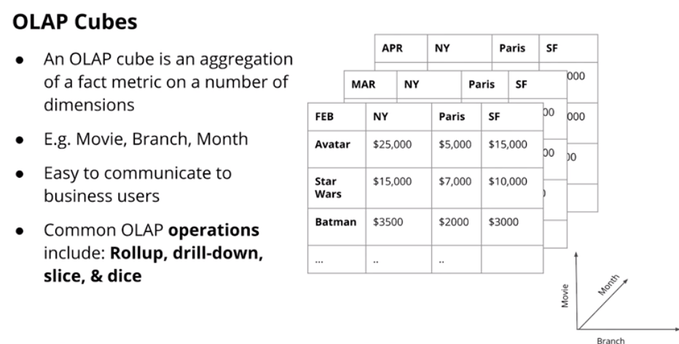
What are Olap Cubes?

Slide 4
What are Olap Cubes? (cont)
Cubes are generally built on top of a star or snowflake schema
Fact Data (aka measurements) must be at the atomic grain
Can have many dimensions (3 or more)
Pros
Easy for business users to understand
Can avoid having to reprocess data - Often helps with BI Applications
Can handle large volumes of data as the results can be stored
LIke OLAP schemas, best of well understood data
Cons
Are less dynamic than directly grouping data on the fly
Generally best as their own entity (aka difficult to join in data)
May require additional tools for storage (depending on delivery)

Slide 5
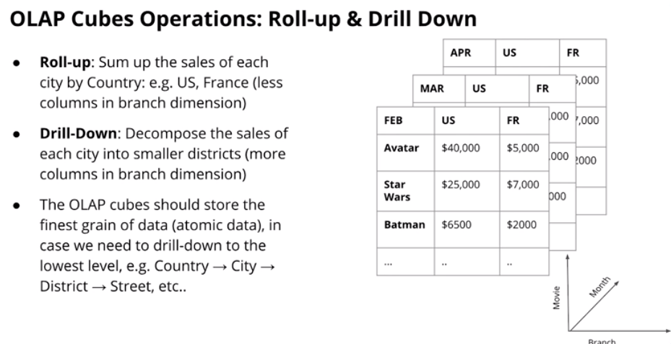
Cube Operations: Roll up and Drill Down

Slide 6
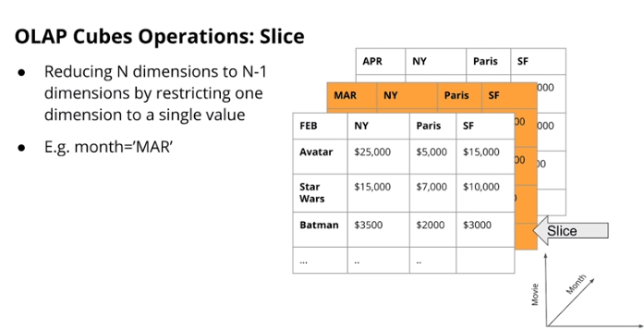
Cube Operations: Slice

Slide 7
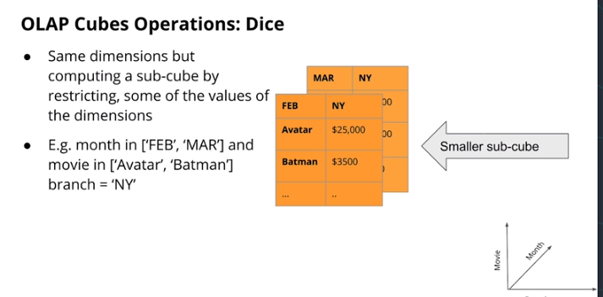
Cube Operations: Dice

Slide 8
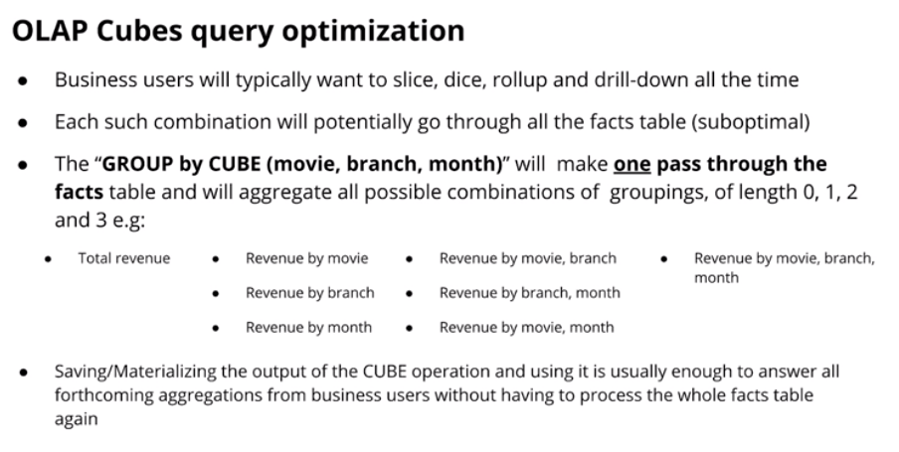
Cube Query Optimization

Slide 9
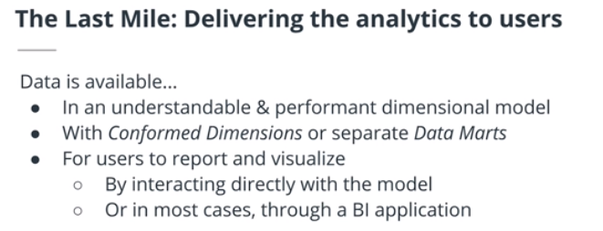
Cube Delivery

Slide 10
Cube Delivery (cont)
Traditional Method
MOLAP - Multi Dimensional OLAP
Provided by a special OLAP Server / Specialized for OLAP Storage
Current Approach
ROLAP - Relational OLAP - Store the data in the RDBMS - Uses a columnar format - Load one column at a time (exadata, redshift etc)

Slide 11
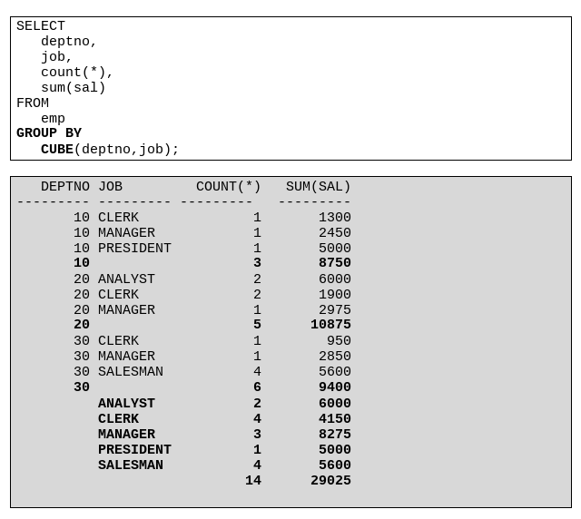
Oracle Cube Example

Slide 12
Demo: Use of Cubes in SAP BW
Financial Planning & Analysis team uses BPC (excel add-on) very heavily as a visual drag-and-drop frontend for SAP BW cubes
Provides a flexible self-service cube GUI that is easy to use for non-technical users
Has almost completely replaced use of SAP extracts in regular reporting

Slide 13
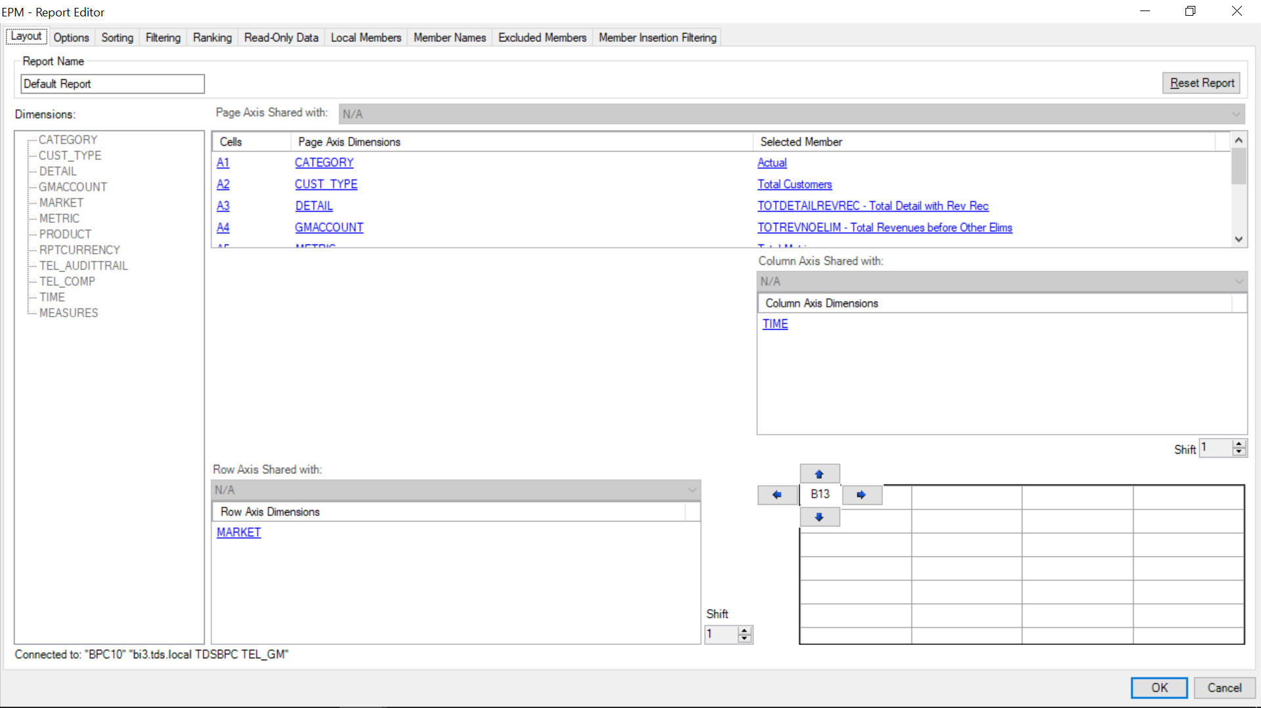
How Does It Work?
Dimensions
Selected Facts

Slide 14
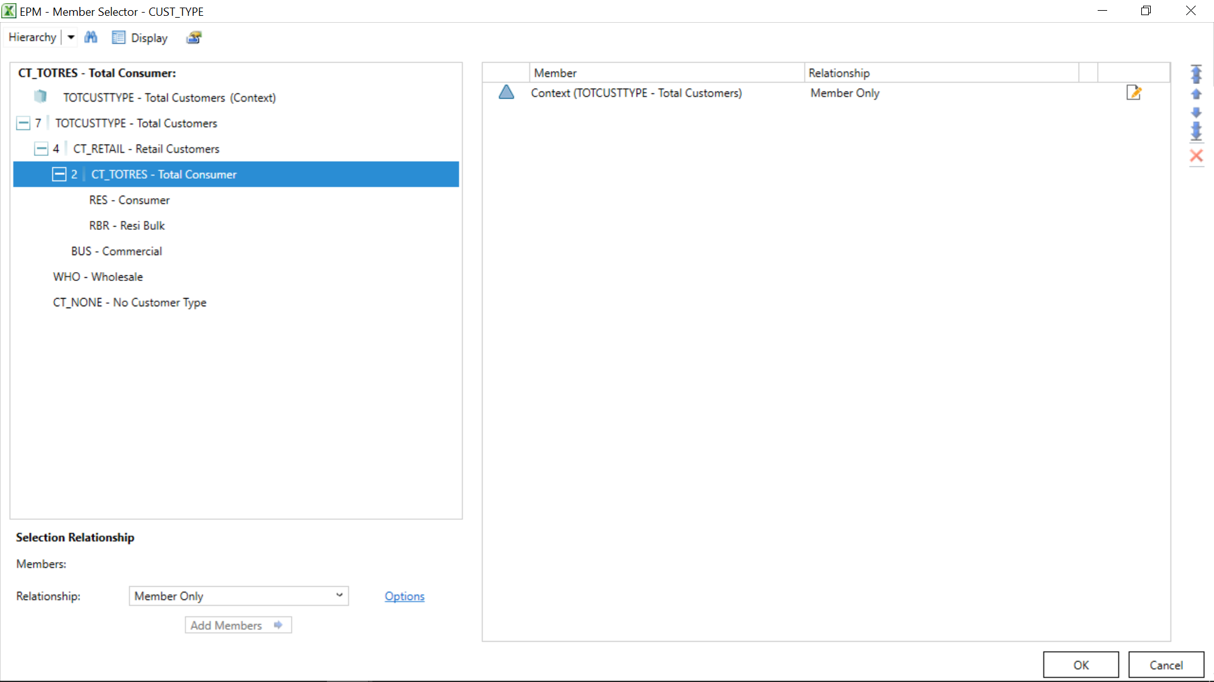
Facts Within a Dimension
Fact Options
Aggregation Level

Slide 15
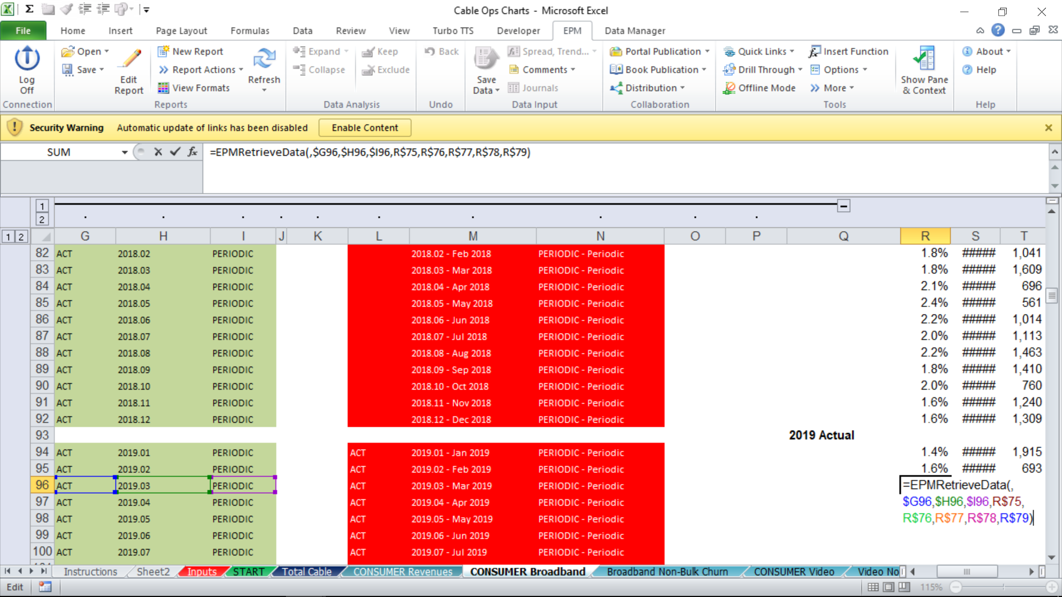
Direct Query Functionality
Allows for direct querying of the cube within an Excel formula, referencing parameters within a spreadsheet
Allows for easy and rapid automation or querying of specific figures

Slide 16
Questions?

